Slide 1
Unit Testing Patterns

Slide 2
Testavimo projekto tikslai
Testai kaip specifikacija
Testai kaip dokumentacija
Testai kaip saugumo tinklas
Defektų lokalizacija
Lengvas testų kūrimas ir palaikymas
Kokybės gerinimas
Rizikos mažinimas
Klaidų vengimas

Slide 3
Testų kūrimo tikslai
Pilnas automatizavimas
Patys tikrinantys testai
Pakartotinai vykdomi testai
Atsparūs testai
Paprasti testai
Išraiškingi testai
Konceptų išskyrimas
Nedarantys žalos

Slide 4
Geras testas
Pakartotinai panaudojamas
Pats tikrinantis
Atsparus
Nedarantis žalos

Slide 5
Testų šablonų tipai
xUnit karkaso pagrindai
Testų automatizavimo
Testo situacijos paruošimo
Testo rezultatų patikrinimo
Testo pradinės būsenos atstatymo
Testų organizavimo
Testavimo objektų pakaitalų (Mocks)
Duomenų bazės
Projektavimo testuojamumui

Slide 6
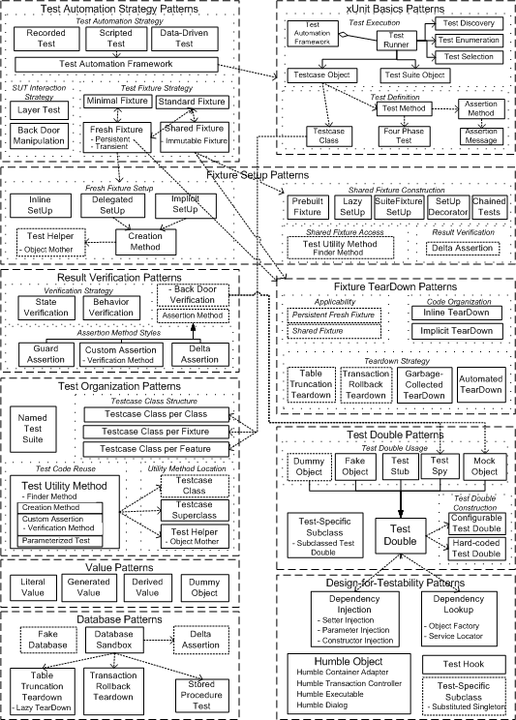

xUnit Test Patterns

Slide 7
xUnit test patterns
Assertion Message (370): We include a descriptive string argument in each call to an Assertion Method.
Assertion Method (362): We call a utility method to evaluate whether an expected outcome has been achieved.
Automated Teardown (503): We keep track of all resources that are created in a test and automatically destroy/free them during teardown.
Back Door Manipulation (327): We set up the test fixture or verify the outcome by going through a back door (such as direct database access).
Behavior Verification (468): We capture the indirect outputs of the system under test (SUT) as they occur and compare them to the expected behavior.
Chained Tests (454): We let the other tests in a test suite set up the test fixture.
Configurable Test Double (558): We configure a reusable Test Double with the values to be returned or verified during the fixture setup phase of a test.
Creation Method (415): We set up the test fixture by calling methods that hide the mechanics of building ready-to-use objects behind Intent-Revealing Names.
Custom Assertion (474): We create a purpose-built Assertion Method that compares only those attributes of the object that define test-specific equality.

Slide 8
xUnit test patterns
Data-Driven Test (288): We store all the information needed for each test in a data fi le and write an interpreter that reads the file and executes the tests.
Database Sandbox (650): We provide a separate test database for each developer or tester.
Delegated Setup (411): Each test creates its own Fresh Fixture by calling Creation Methods from within the Test Methods.
Delta Assertion (485): We specify assertions based on differences between the pre- and post-exercise state of the SUT.
Dependency Injection (678): The client provides the depended-on object to the SUT.
Dependency Lookup (686): The SUT asks another object to return the depended-on object before it uses it.
Derived Value (718): We use expressions to calculate values that can be derived from other values.
Dummy Object (728): We pass an object that has no implementation as an argument of a method called on the SUT.

Slide 9
xUnit test patterns
Fake Object (551): We replace a component that the SUT depends on with a much lighter-weight implementation.
Four-Phase Test (358): We structure each test with four distinct parts executed in sequence.
Fresh Fixture (311): Each test constructs its own brand-new test fixture for its own private use.
Garbage-Collected Teardown (500): We let the garbage collection mechanism provided by the programming language clean up after our test.
Generated Value (723): We generate a suitable value each time the test is run.
Guard Assertion (490): We replace an if statement in a test with an assertion that fails the test if not satisfied.
Hard-Coded Test Double (568): We build the Test Double by hard-coding the return values and/or expected calls.
Humble Object (695): We extract the logic into a separate, easy-to-test component that is decoupled from its environment.

Slide 10
xUnit test patterns
Implicit Setup (424): We build the test fixture common to several tests in the setUp method.
Implicit Teardown (516): The Test Automation Framework calls our clean up logic in the tearDown method after every Test Method.
In-line Setup (408): Each Test Method creates its own Fresh Fixture by calling the appropriate constructor methods to build exactly the test fixture it requires.
In-line Teardown (509): We include teardown logic at the end of the Test Method immediately after the result verification.
Layer Test (337): We can write separate tests for each layer of the layered architecture.
Lazy Setup (435): We use Lazy Initialization of the fixture to create it in the first test that needs it.
Literal Value (714): We use literal constants for object attributes and assertions.
Minimal Fixture (302): We use the smallest and simplest fixture possible for each test.
Mock Object (544): We replace an object the SUT depends on with a test-specific object that verifies it is being used correctly by the SUT.

Slide 11
xUnit test patterns
Named Test Suite (592): We define a test suite, suitably named, that contains a set of tests that we wish to be able to run as a group.
Parameterized Test (607): We pass the information needed to do fixture setup and result verification to a utility method that implements the entire test life cycle.
Prebuilt Fixture (429): We build the Shared Fixture separately from running the tests.
Recorded Test (278): We automate tests by recording interactions with the application and playing them back using a test tool.
Scripted Test (285): We automate the tests by writing test programs by hand.
Setup Decorator (447): We wrap the test suite with a Decorator that sets up the shared test fixture before running the tests and tears it down after all the tests are done.
Shared Fixture (317): We reuse the same instance of the test fixture across many tests.

Slide 12
xUnit test patterns
Standard Fixture (305): We reuse the same design of the test fixture across many tests.
State Verification (462): We inspect the state of the SUT after it has been exercised and compare it to the expected state.
Stored Procedure Test (654): We write Fully Automated Tests for each stored procedure.
Suite Fixture Setup (441): We build/destroy the shared fixture in special methods called by the Test Automation Framework
before/after the first/last Test Method is called.
Table Truncation Teardown (661): We truncate the tables modified during the test to tear down the fixture.
Test Automation Framework (298): We use a framework that provides all the mechanisms needed to run the test logic so the test writer needs to provide only the test-specific logic.
Test Discovery (393): The Test Automation Framework discovers all the tests that belong to the test suite automatically.

Slide 13
xUnit test patterns
Test Double (522): We replace a component on which the SUT depends with a “test-specific equivalent.”
Test Enumeration (399): The test automater manually writes the code that enumerates all tests that belong to the test suite.
Test Helper (643): We define a helper class to hold any Test Utility Methods we want to reuse in several tests.
Test Hook (709): We modify the SUT to behave differently during the test.
Test Method (348): We encode each test as a single Test Method on some class.
Test Runner (377): We define an application that instantiates a Test Suite Object and executes all the Testcase Objects it contains.
Test Selection (403): The Test Automation Framework selects the Test Methods to be run at runtime based on attributes of the tests.

Slide 14
xUnit test patterns
Test Spy (538): We use a Test Double to capture the indirect output calls made to another component by the SUT for later verification by the test.
Test Stub (529): We replace a real object with a test-specific object that feeds the desired indirect inputs into the SUT.
Test Suite Object (387): We define a collection class that implements the standard test interface and use it to run a set of related Testcase Objects.
Test Utility Method (599): We encapsulate the test logic we want to reuse behind a suitably named utility method.
Test-Specific Subclass (579): We add methods that expose the state or behavior needed by the test to a subclass of the SUT.

Slide 15
xUnit test patterns
Testcase Class (373): We group a set of related Test Methods on a single Testcase Class.
Testcase Class per Class (617): We put all the Test Methods for one SUT class onto a single Testcase Class.
Testcase Class per Feature (624): We group the Test Methods onto Testcase Classes based on which testable feature of the SUT they exercise.
Testcase Class per Fixture (631): We organize Test Methods into Testcase Classes based on commonality of the test fixture.
Testcase Object (382): We create a Command object for each test and call the run method when we wish to execute it.
Testcase Superclass (638): We inherit reusable test-specific logic from an abstract Testcase Superclass.
Transaction Rollback Teardown (668): We roll back the uncommitted test transaction as part of the teardown.
Unfinished Test Assertion (494): We ensure that incomplete tests fail by executing an assertion that is guaranteed to fail.

Slide 16
Tests refactoring
Turime netvarkingai sukurtą testą
Pertvarkysime jį taip kad tenkintų anksčiau aprašytus kriterijus.

Slide 17
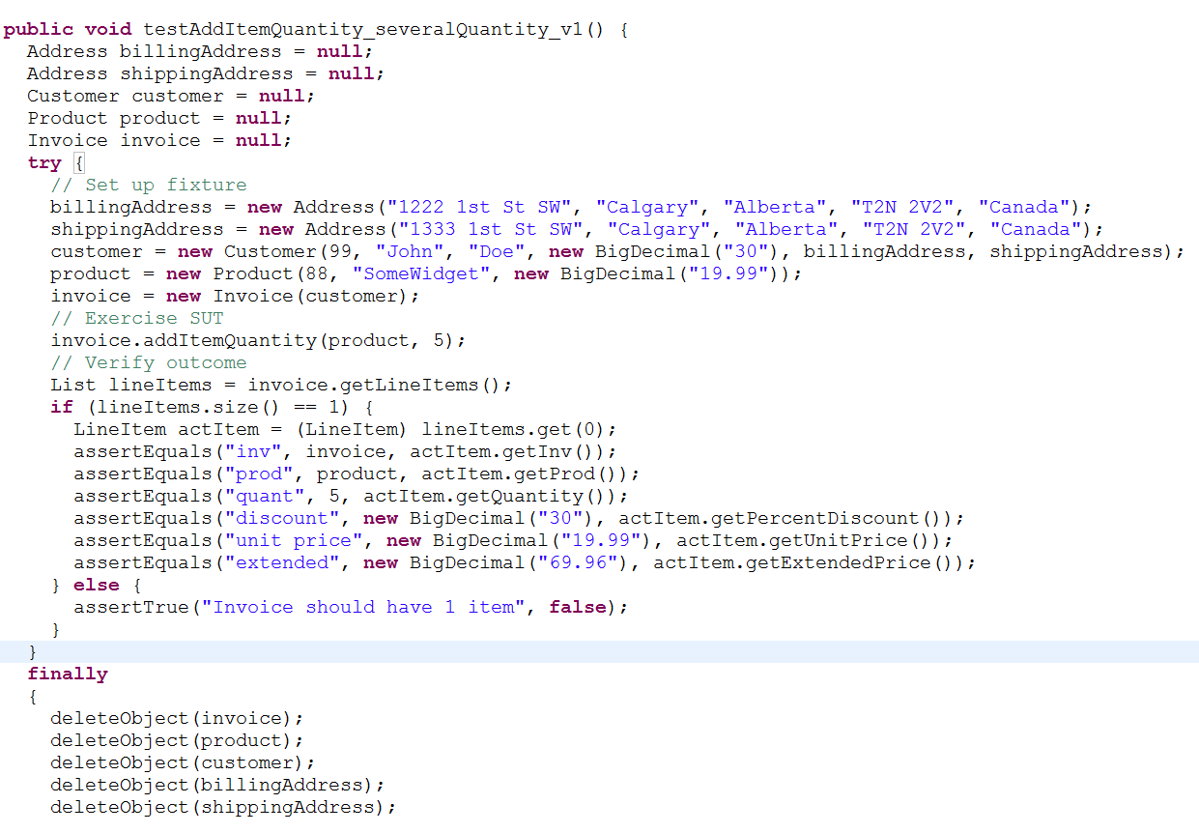
Baisus testas

Slide 18
Testo taisymas
Patikrinimo sąlygų sutvarkymas
Išsišakojimų panaikinimas
Objektų sunaikinimo sutvarkymas
Testo pradinės sąlygos sutvarkymas
Konstantų sutvarkymas

Slide 19
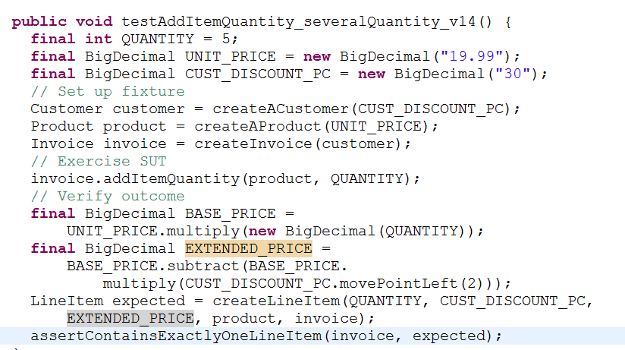
Sutvarkytas testas

Slide 20
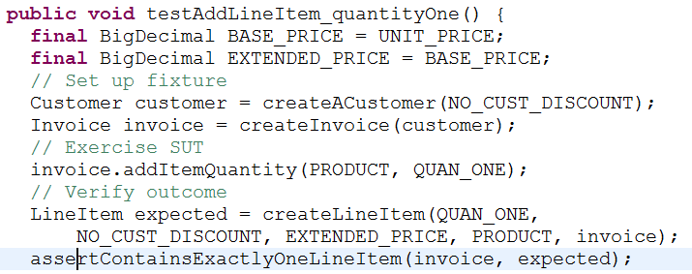
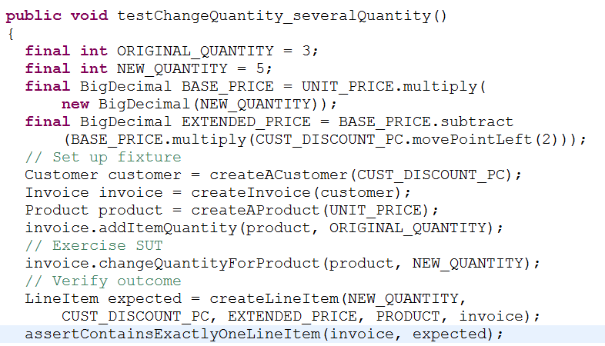
Papildomų testų kūrimas

Slide 21
Q/A s.v.p.

